Slide 1
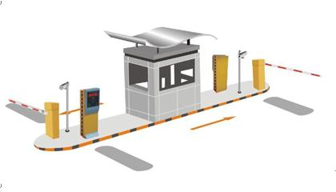
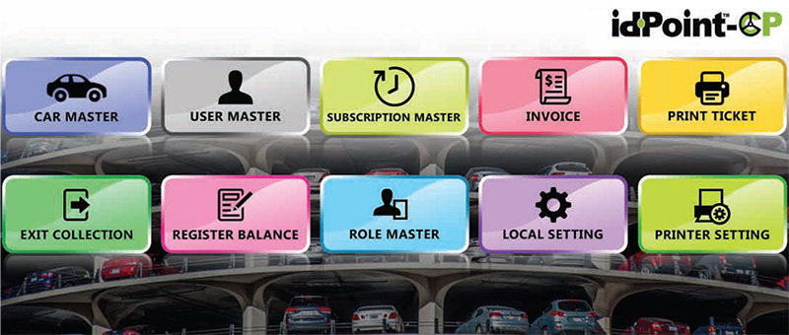
Parking Management System
Muhammad Ali
00732065

Slide 2

The main features of an impressive PMS are
LCD Display, to easily view the information.
Ticket Dispensing Unit, for easier disposal of tickets.
Intercom installation, to communicate effectively.
Illuminated Ticket Request Button, to easily obtain the parking ticket.
The automated access control system provides modern day features like Automatic Gates, Barrier Controls, Ticketing systems, Authentication, Biometric scans, etc.

Slide 3
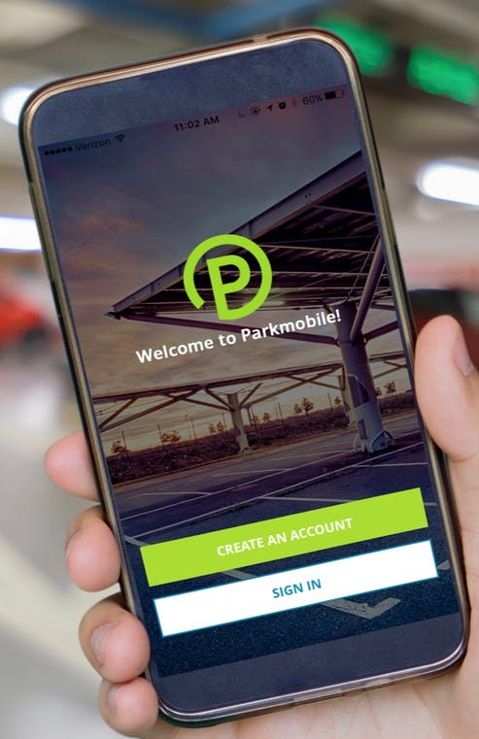
Sign in / register

Slide 4
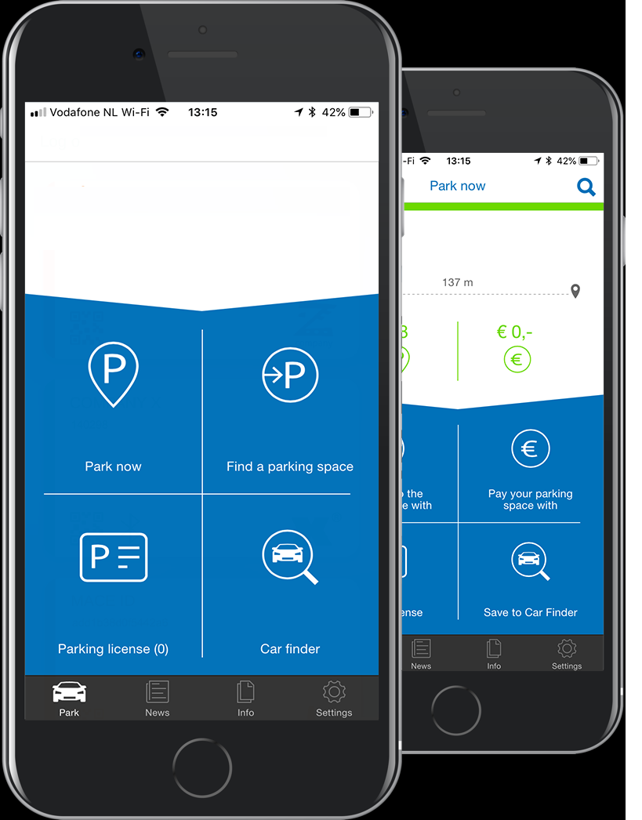

Slide 5
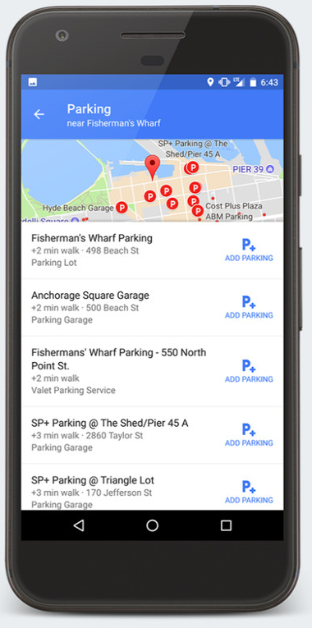
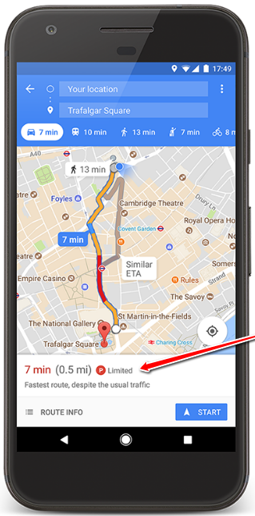
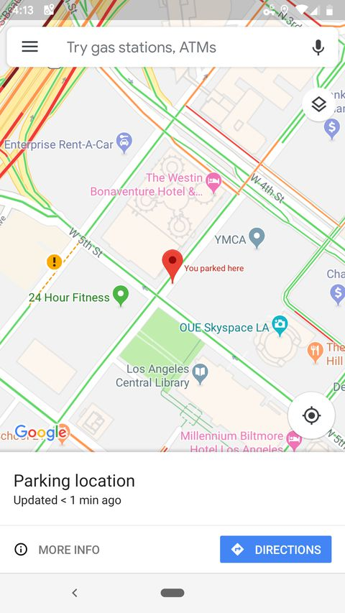
Find Location

Slide 6
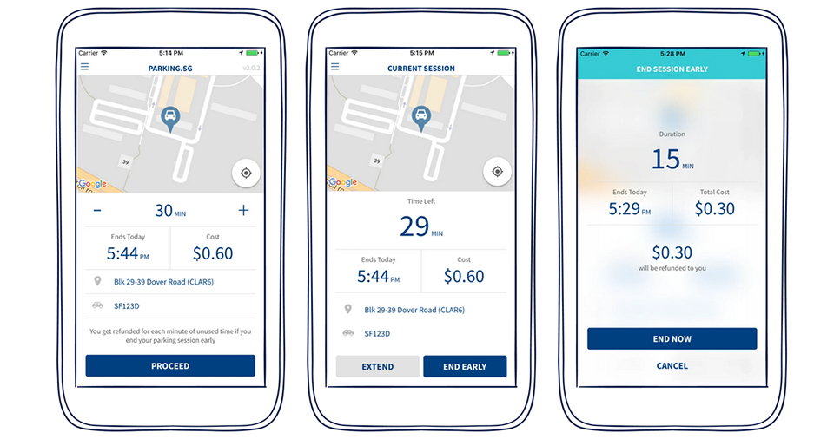
Duration and Payment

Slide 7
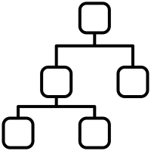

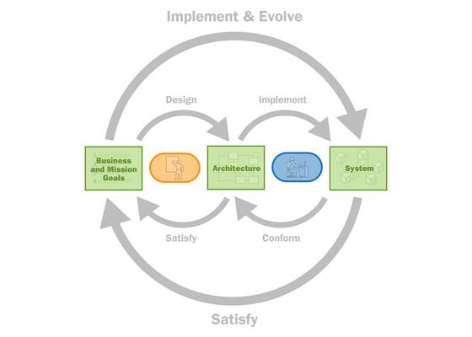


software architecture

Slide 8
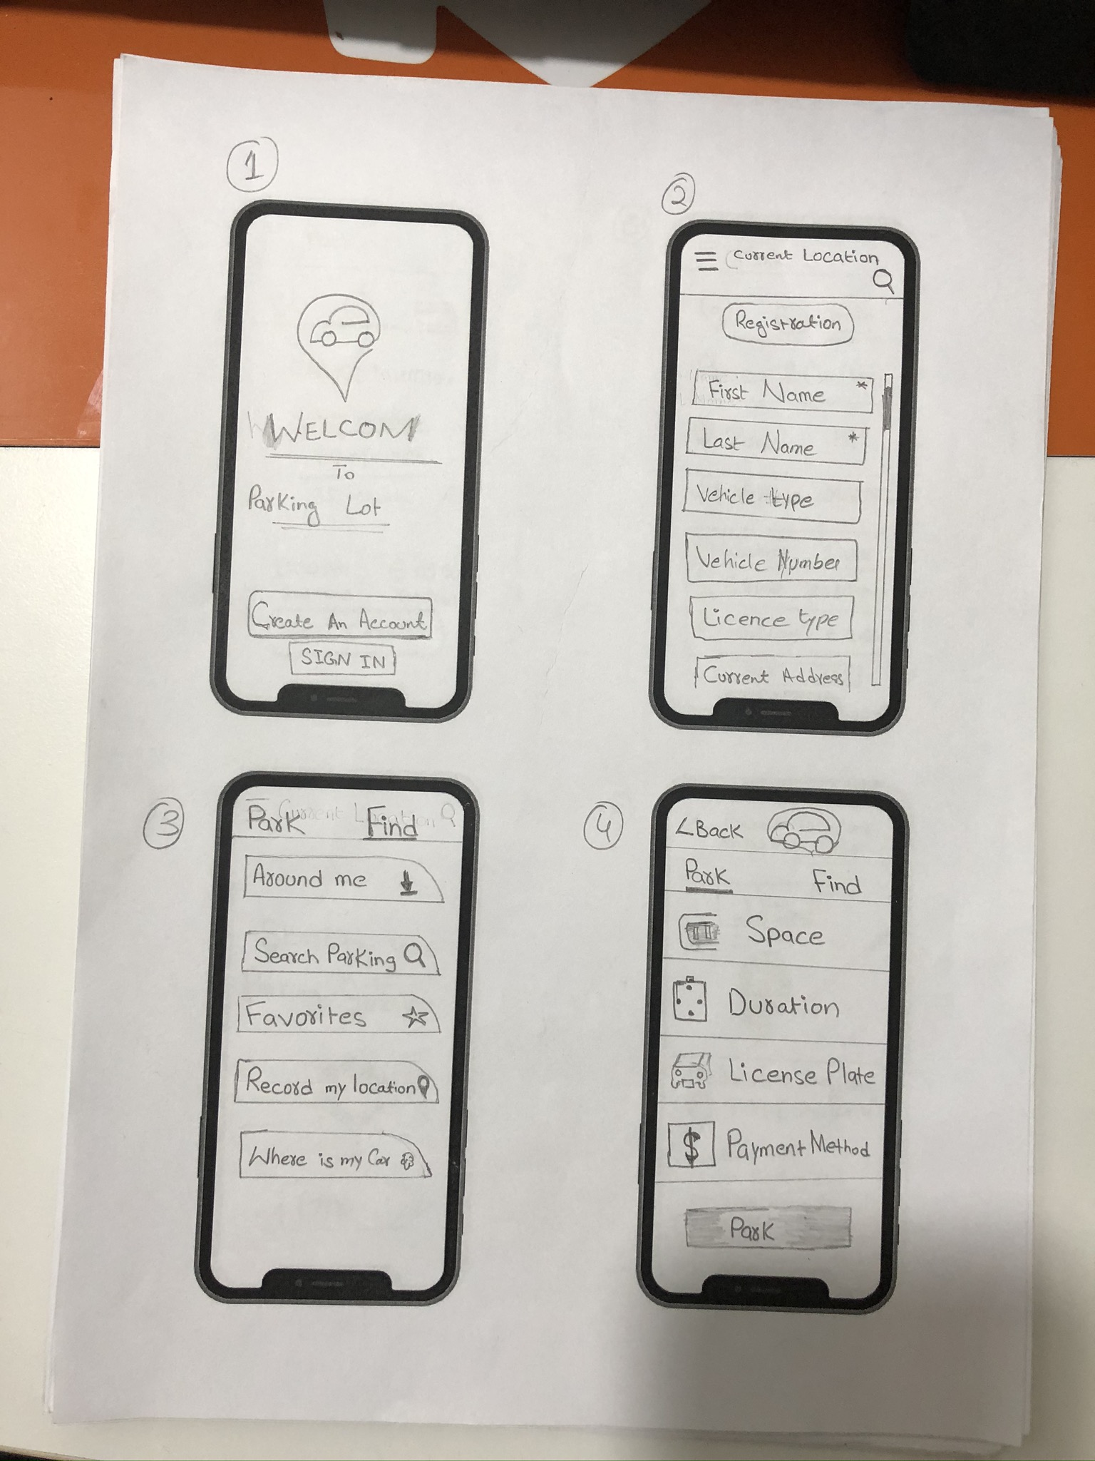
Paper Prototype

Slide 9
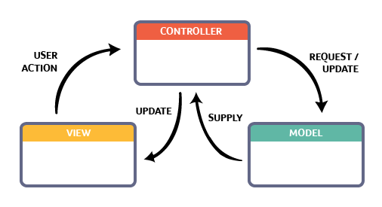
Software Architectural Patterns
This pattern, also known as MVC pattern, divides an interactive application in to 3 parts as,

Slide 10


Slide 11
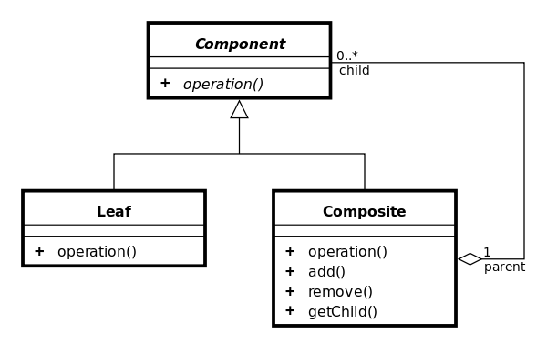
Composite design pattern

Slide 12
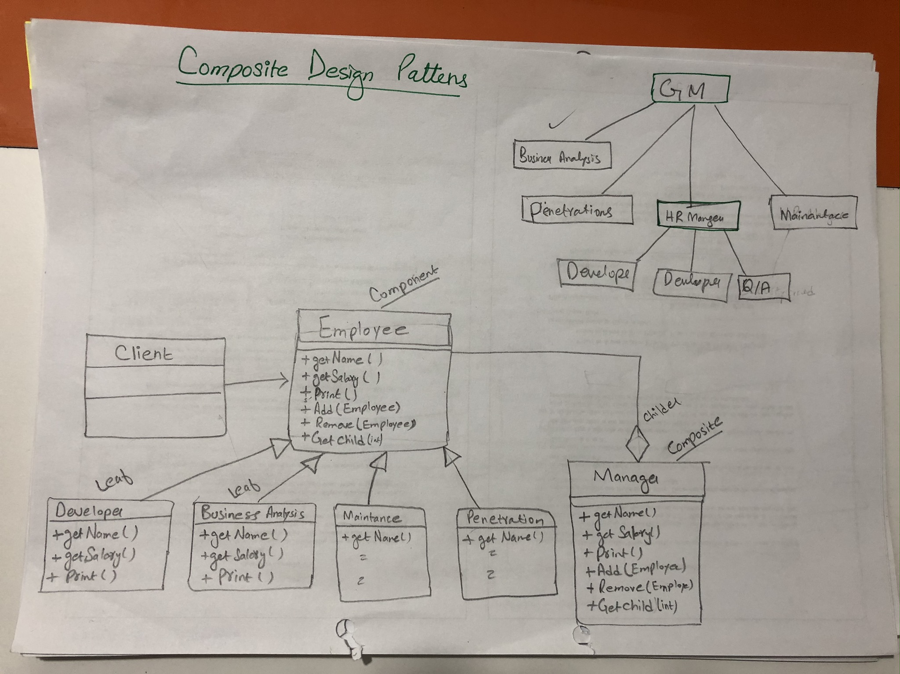

Slide 13
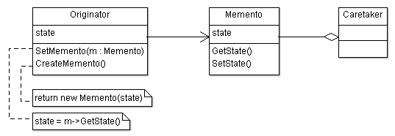
memento design pattern

Slide 14
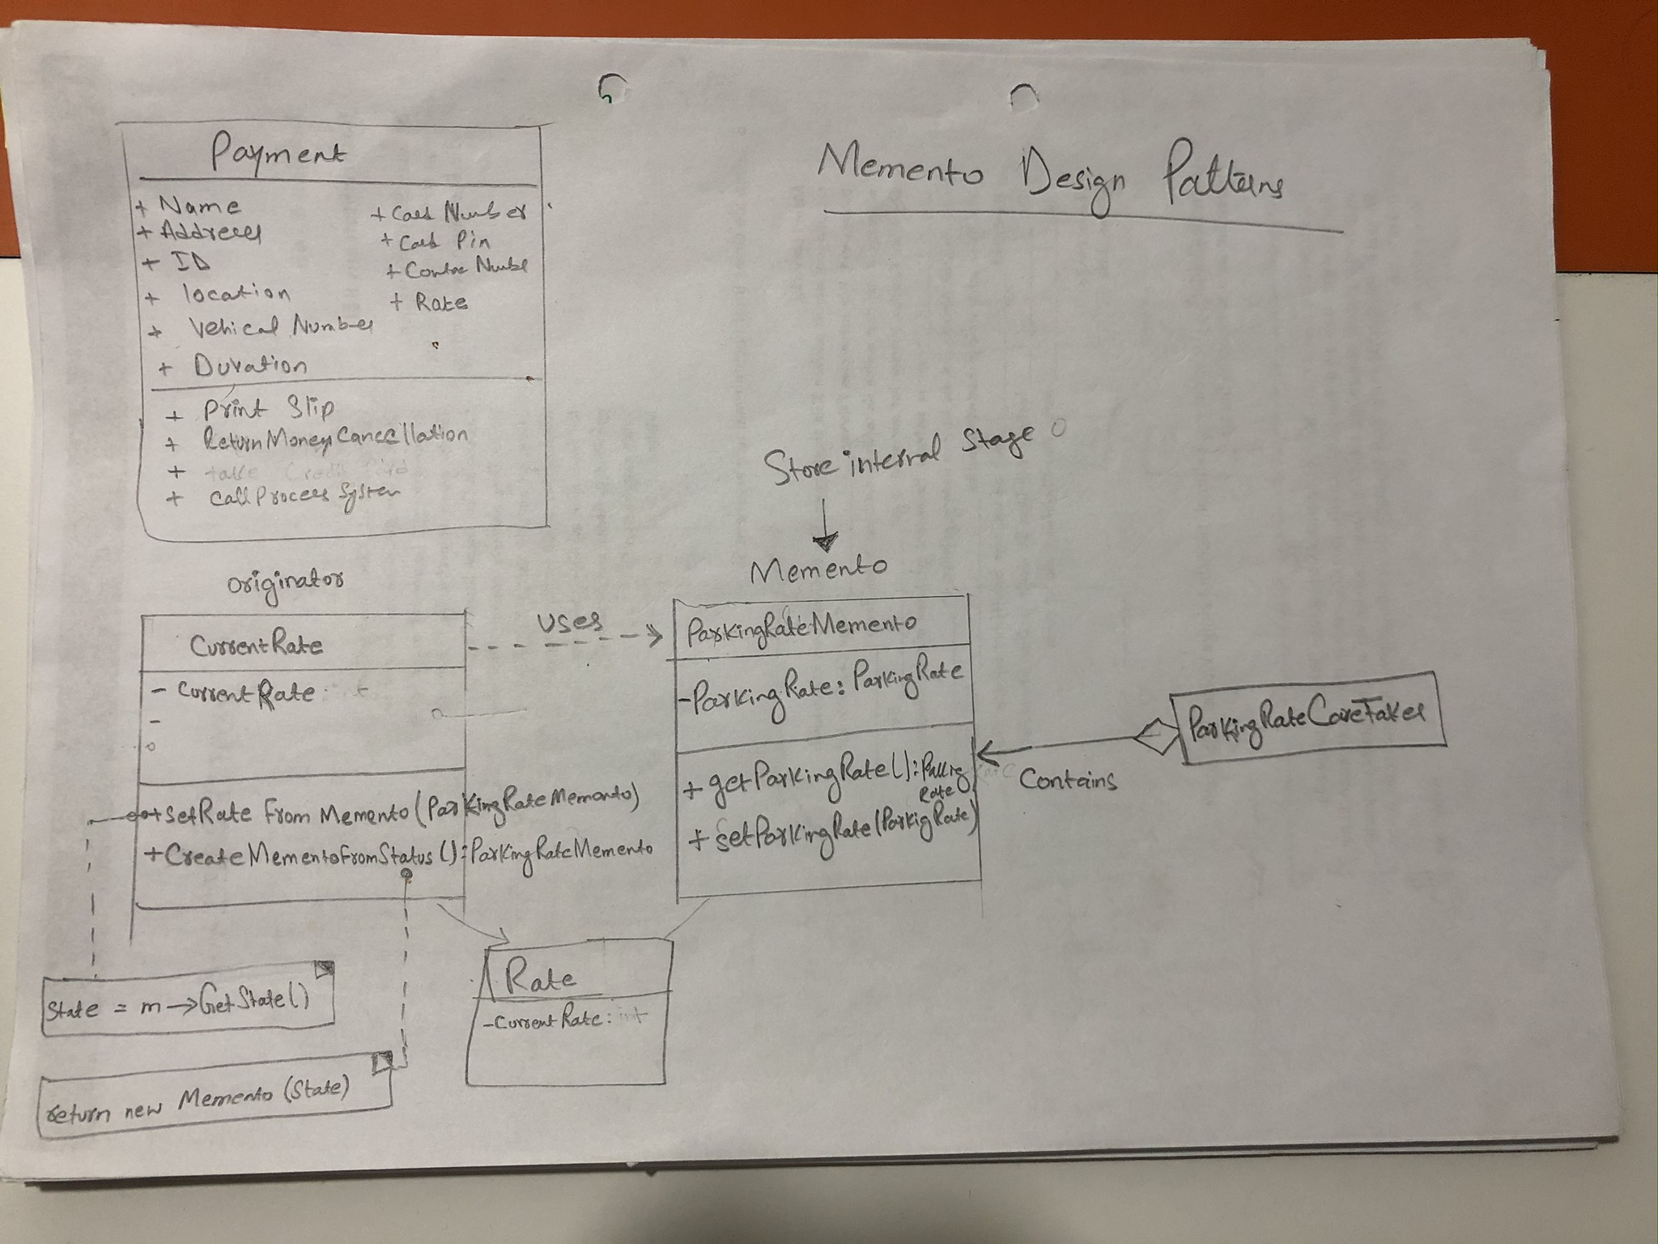

Slide 15
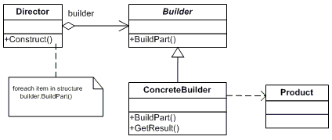
builder design pattern

Slide 16
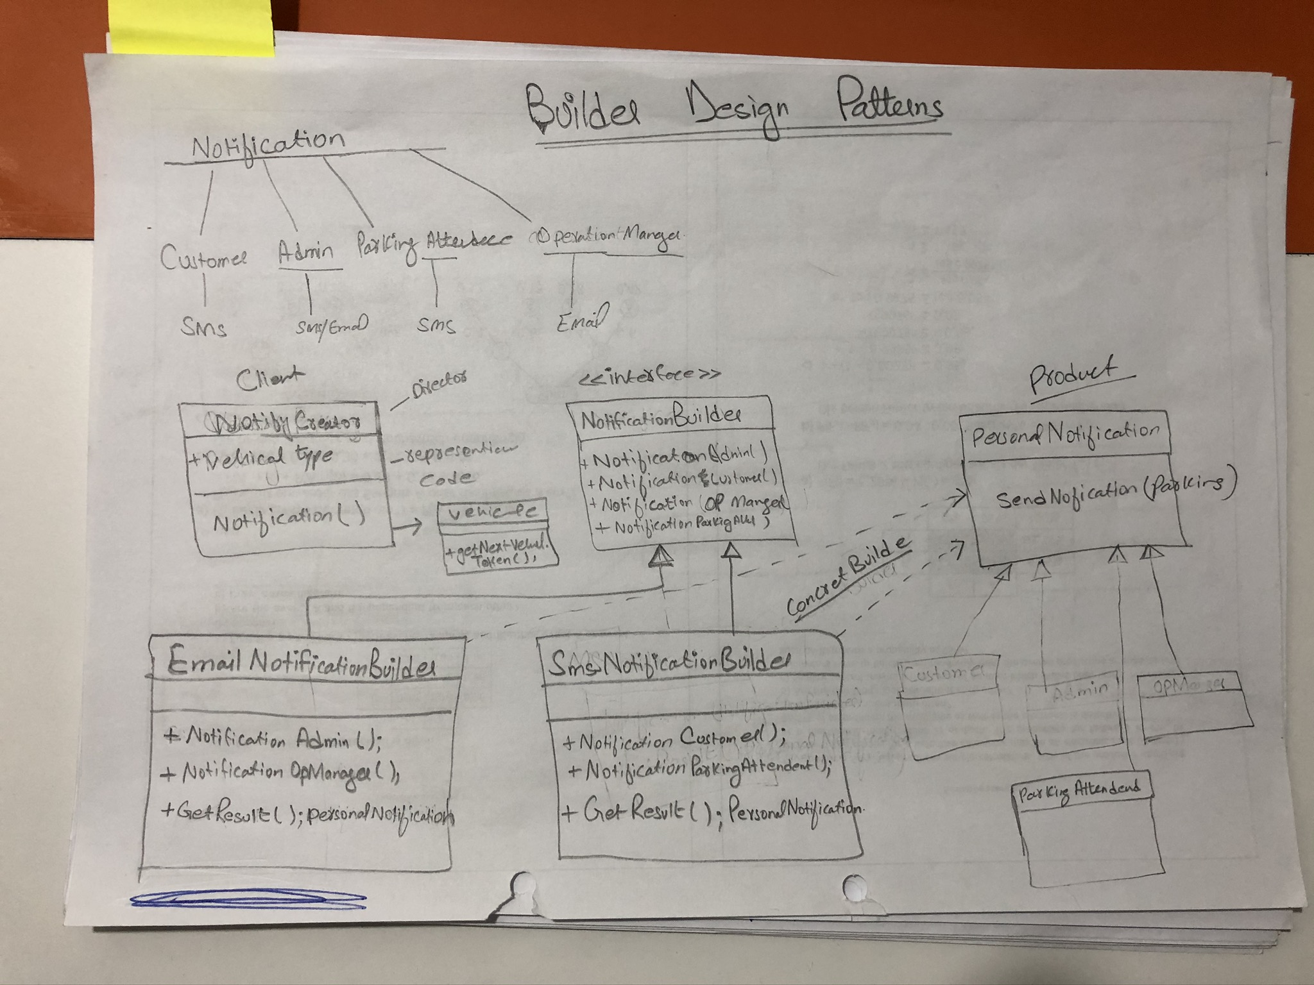

Slide 17
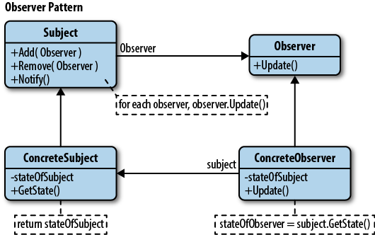
observer design pattern

Slide 18
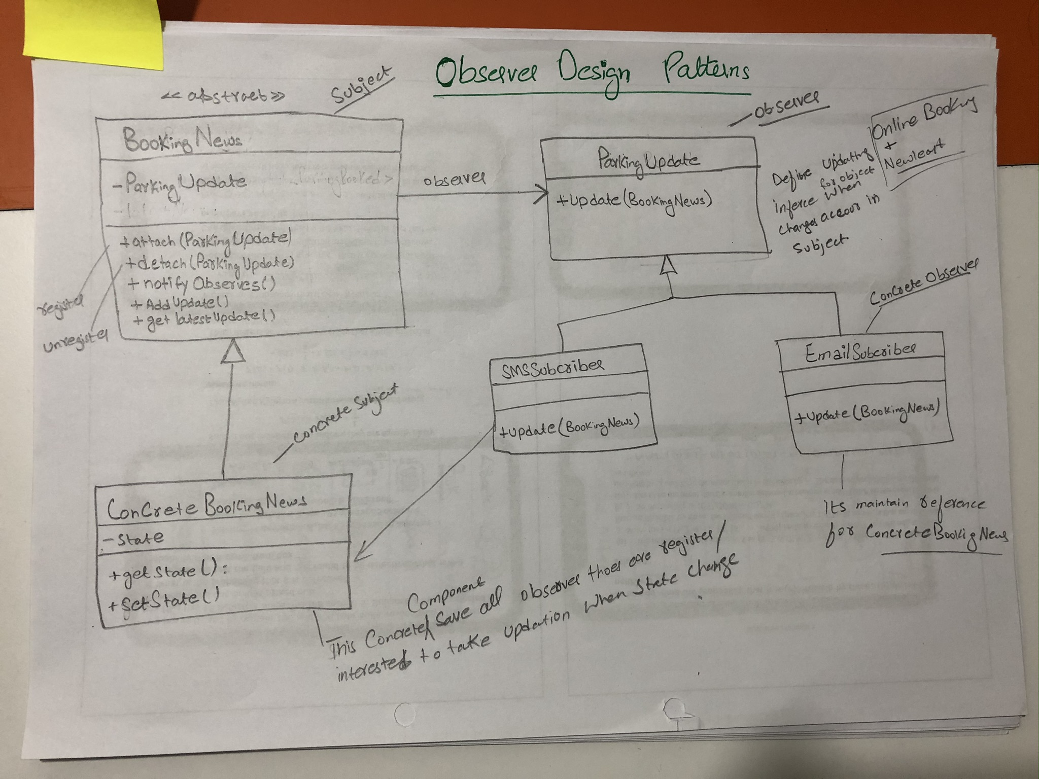

Slide 19
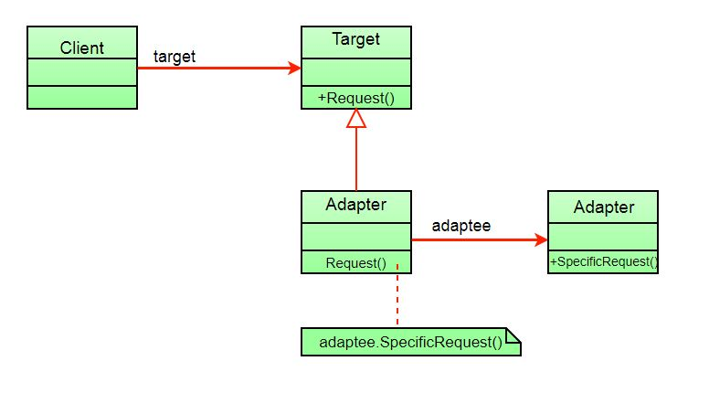
adapter design pattern

Slide 20
